Slide 1
Unit 4
Transaction Management

Slide 2
Objective
What is mean by transaction?
ACID properties
Why Concurrency control is needed
Concept of schedule
Serializability
Concurrency control techniques
Deadlock
Different Crash Recovery methods

Slide 3
Transaction Management
A transaction is one or more SQL statements that make up a unit of work performed against the database, and either all the statements in a transaction are committed as a unit or all the statements are rolled back as a unit.
This unit of work typically satisfies a user request and ensures data integrity.

Slide 4
Transaction Management
TPS are the systems with large databases
Hundreds of concurrent users executing database transactions
Examples are airline reservations, banking, credit card processing, stock markets, supermarket and so on
These system requires high availability & fast response time

Slide 5
Transaction Management
When you transfer money from one bank account to another, the request involves a transaction: updating values stored in the database for both accounts.
For a transaction to be completed and database changes to be made permanent, a transaction must be completed in its entirety.

Slide 6
Transaction Management
A transaction is a sequence of logical DML operations
A transaction is said to be completed when we issue a commit.
Commit - saves the changes permanently
Changes made through a transaction can be undone by the use of rollback
Rollback after commit is useless

Slide 7
Properties of Transactions
For a transaction to be called successful it must satisfy ACID properties
ACID (atomicity, consistency, isolation, durability) is a set of properties that guarantee database transactions are processed reliably
Jim Gray defined these properties of a reliable transaction system in the late 1970s

Slide 8
ACID Properties of Transactions
Atomicity
  All changes to data are performed as if they are a single operation. That is, all the changes are performed, or none of them are.
  For example, in an application that transfers funds from one account to another, the atomicity property ensures that, if a debit is made successfully from one account, the corresponding credit is made to the other account.

Slide 9
ACID Properties of Transactions
Consistency
  Data is in a consistent state when a transaction starts and when it ends.
  For example, in an application that transfers funds from one account to another, the consistency property ensures that the total value of funds in both the accounts is the same at the start and end of each transaction.

Slide 10
ACID Properties of Transactions
Isolation
  The intermediate state of a transaction is invisible to other transactions. As a result, transactions that run concurrently appear to be serialized.
  For example, in an application that transfers funds from one account to another, the isolation property ensures that another transaction sees the transferred funds in one account or the other, but not in both, nor in neither.

Slide 11
ACID Properties of Transactions
Durability
  After a transaction successfully completes, changes to data persist and are not undone, even in the event of a system failure.
  For example, in an application that transfers funds from one account to another, the durability property ensures that the changes made to each account will not be reversed.

Slide 12
Single user Vs Multiuser systems
A DBMS is a single-user if at most one user at a time can use system
In multiuser, many users can use the system
Hence access the database concurrently
Single user DBMS are mostly restricted to personal computer system
Most other DBMS are multiuser

Slide 13
Concurrency
It is property of system in which several computations are executing simultaneously and interacting with each other
Concurrent processes often need access to shared data and shared resources
Concurrent execution of processes is interleaved
Interleaving also prevents a long process from delaying other process

Slide 14
Concurrency control
Concurrency control deals with preventing concurrently running processes from improperly inserting, deleting, or updating the same data.
concurrency control ensures that correct results for concurrent operations are generated, while getting those results as quickly as possible.
Concurrency control in Database management systems ensures that database transactions are performed concurrently without violating the data integrity of the respective databases.

Slide 15
Concurrency control
Process of managing simultaneous operations on the database without having them interfere with one another.
Prevents interference when two or more users are accessing database simultaneously and at least one is updating data.
Although two transactions may be correct in themselves, interleaving of operations may produce an incorrect result

Slide 16
Need of concurrency control
If concurrent transactions with interleaving operations are allowed in an uncontrolled manner, some unexpected result may occur.
Three basic problems caused by concurrency:
Lost update problem
Uncommitted dependency problem
Inconsistent analysis problem.

Slide 17
Lost Update Problem
Successfully completed update is overridden by another user.
Example:
T1 withdraws £10 from an account with balx, initially £100.
T2 deposits £100 into same account.
Serially, final balance would be £190.

Slide 18
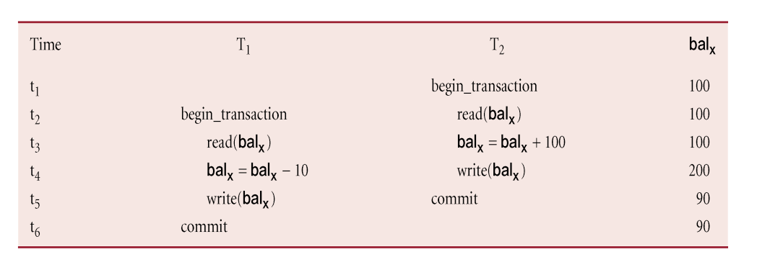
Lost Update Problem
Loss of T2's update!!
This can be avoided by preventing T1 from reading balx until after update.

Slide 19
Uncommitted Dependency Problem
Occurs when one transaction can see intermediate results of another transaction before it has committed.
Example:
T4 updates balx to £200 but it aborts, so balx should be back at original value of £100.
T3 has read new value of balx (£200) and uses value as basis of £10 reduction, giving a new balance of £190, instead of £90.

Slide 20
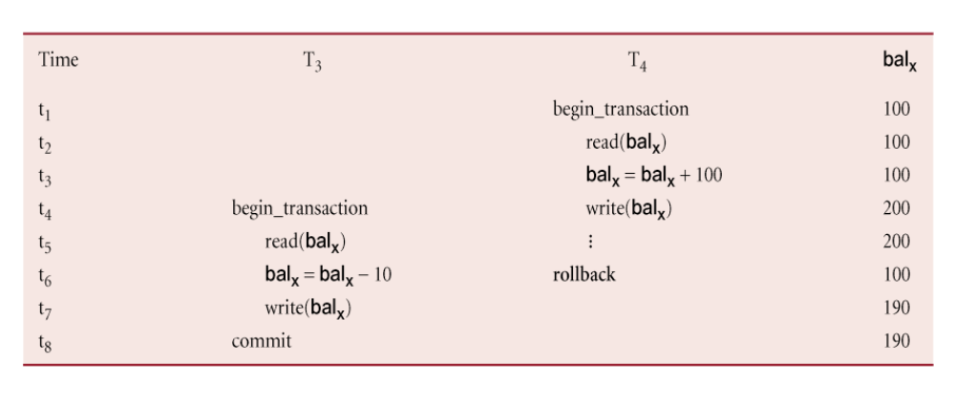
Uncommitted Dependency Problem
Problem avoided by preventing T3 from reading balx until after T4 commits or aborts.

Slide 21
Inconsistent Analysis Problem
Occurs when transaction reads several values but second transaction updates some of them during execution of first.
Example:
T6 is totaling balances of account x (£100), account y (£50), and account z (£25).
Meantime, T5 has transferred £10 from balx to balz, so T6 now has wrong result (£10 too high).

Slide 22
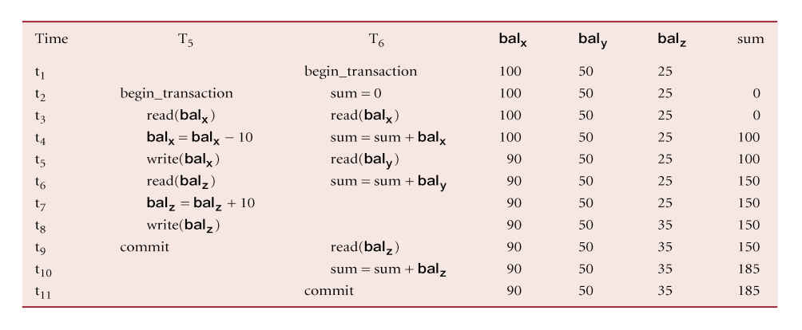
Inconsistent Analysis Problem
Problem avoided by preventing T6 from reading balx and balz until after T5 completed updates.

Slide 23
Serializability
Objective of a concurrency control protocol is to schedule transactions in such a way as to avoid any interference.
Possible solution: Run all transactions serially.
This is often too restrictive as it limits degree of concurrency or parallelism in system.
Serializability identifies those executions of transactions guaranteed to ensure consistency.

Slide 24
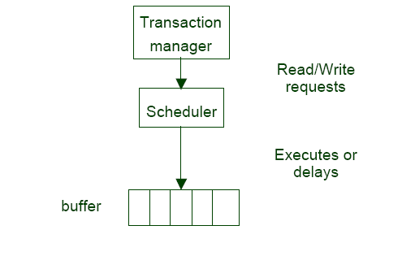
The scheduler
The scheduler component of a DBMS must ensure that the individual steps of different transactions preserve consistency.

Slide 25
Schedule
Executions of transactions running in the system
Serial Schedule: a schedule where the operations of each transaction are executed consecutively without any interleaved operations from other transactions.

Slide 26
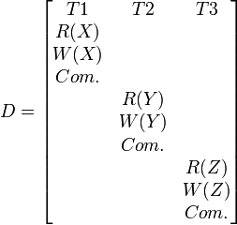
Serial Schedule
D = R1(X) W1(X) Com1 R2(Y) W2(Y) Com2 R3(Z) W3(Z) Com3

Slide 27
Nonserial Schedule:
Schedule where operations from a set of concurrent transactions are interleaved.
The objective of Serializability is to find nonserial schedules that allow transactions to execute concurrently without interfering with one another.
In other words, want to find nonserial schedules that are equivalent to some serial schedule. Such a schedule is called serializable.

Slide 28
Serializability - some important rules
In Serializability, ordering of read/writes is important:
(a) If two transactions only read a data item, they do not conflict and order is not important.
(b) If two transactions either read or write completely separate data items, they do not conflict and order is not important.
(c) If one transaction writes a data item and another reads or writes same data item, order of execution is important

Slide 29
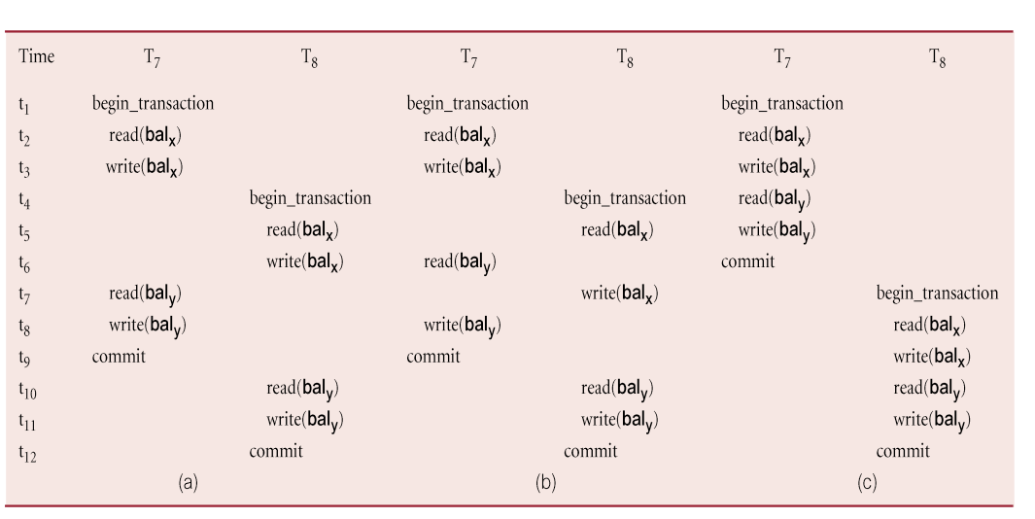
Example of Conflict Serializability

Slide 30
Conflict Serializability
Conflict serializable schedule orders any conflicting operations in same way as some serial execution.
Constrained write rule: transaction updates data item based on its old value, which is first read.
Under the constrained write rule we can use precedence graph to test for Serializability.

Slide 31
View Serializability
Offers less stringent definition of schedule equivalence than conflict serializability.
Two schedules S1 and S2 are view equivalent if:
• For each data item x, if Ti reads initial value of x in S1, Ti must also read initial value of x in S2.
• For each read on x by Ti in S1, if value read by x is written by Tj, Ti must also read value of x produced by Tj in S2.
• For each data item x, if last write on x performed by Ti in S1, same transaction must perform final write on x in S2.

Slide 32
View Serializability
Schedule is view serializable if it is view equivalent to a serial schedule.
Every conflict serializable schedule is view serializable, although converse is not true.
It can be shown that any view serializable schedule that is not conflict serializable contains one or more blind writes.
In general, testing whether schedule is serializable is NP-complete.

Slide 33
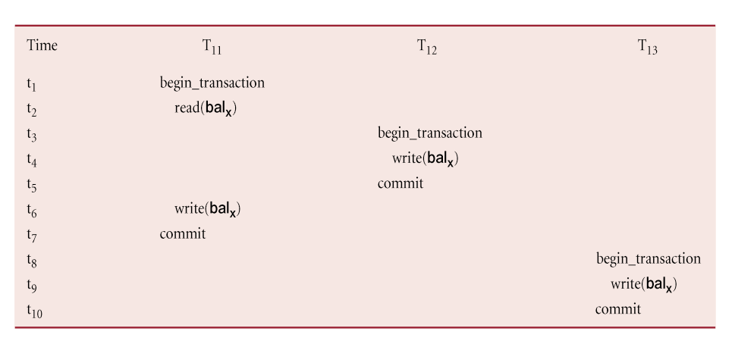
Example - View Serializable schedule

Slide 34
Recoverability
Serializability identifies schedules that maintain database consistency, assuming no transaction fails.
Could also examine recoverability of transactions within schedule.
If transaction fails, atomicity requires effects of transaction to be undone.
Durability states that once transaction commits, its changes cannot be undone (without running another, compensating, transaction).

Slide 35
Recoverable Schedule
A schedule where, for each pair of transactions Ti and Tj, if Tj reads a data item previously written by Ti, then the commit operation of Ti precedes the commit operation of Tj.

Slide 36
HOW CAN THE DBMS ENSURE
SERIALIZABILITY?

Slide 37
Concurrency control mechanisms
Two basic concurrency control techniques:
  Locking methods
  Timestamping
Both are conservative approaches: delay transactions in case they conflict with other transactions.
Optimistic methods assume conflict is rare and only check for conflicts at commit.

Slide 38
Locking
Transaction uses locks to deny access to other transactions and so prevent incorrect updates.
Generally, a transaction must claim a
  read (shared), or
  write (exclusive)
lock on a data item before read or write.
Lock prevents another transaction from modifying item or even reading it, in the case of a write lock.

Slide 39
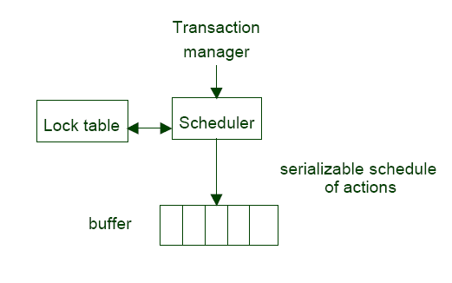
Locking

Slide 40
Locking - Basic Rules
If transaction has shared lock on item, can read but not update item.
If transaction has exclusive lock on item, can both read and update item.
Reads cannot conflict, so more than one transaction can hold shared locks simultaneously on same item.
Exclusive lock gives transaction exclusive access to that item.
Some systems allow transaction to upgrade a shared lock to an exclusive lock, or vice-versa.

Slide 41
Example - Incorrect Locking Schedule
Time T9 T10
T1 begin_transaction
t2 read(balx)
t3 balx = balx +100
T4 write(balx) begin_transaction
T5 read(balx)
T6 balx = balx *1.1
T7 write(balx)
t8 read(baly)
t9 baly = baly *1.1
T10 write(baly)
t11 read(baly) commit
t12 baly = baly -100
T13 write(baly)
T14 commit

Slide 42
Example - Incorrect Locking Schedule
If at start, balx = 100, baly = 400, result should be:
• balx = 220, baly = 330, if T9 executes before T10, or
• balx = 210, baly = 340, if T10 executes before T9 .
However, result gives balx = 220 and baly = 340.

Slide 43
Example - Incorrect Locking Schedule
A valid schedule using the basic rules of locking is:
S = {write_lock(T9, balx), read(T9, balx), write(T9, balx), unlock(T9, balx), write_lock(T10, balx), read(T10, balx), write(T10, balx), unlock(T10, balx), write_lock(T10, baly), read(T10, baly), write(T10, baly), unlock(T10, baly),
commit(T10), write_lock(T9, baly), read(T9, baly), write(T9, baly), unlock(T9, baly), commit(T9) }

Slide 44
Example - Incorrect Locking Schedule
Problems arise when transactions release locks too soon, resulting in loss of total isolation and atomicity.
To guarantee serializability, need an additional protocol concerning the positioning of lock and unlock operations in every transaction.

Slide 45
Two-Phase Locking (2PL)
A transaction follows 2PL protocol if all locking operations precede first unlock operation in the transaction.
We can split the transaction in two phases:
Growing phase - acquires all locks but cannot release any locks.
Shrinking phase - releases locks but cannot acquire any new locks.

Slide 46
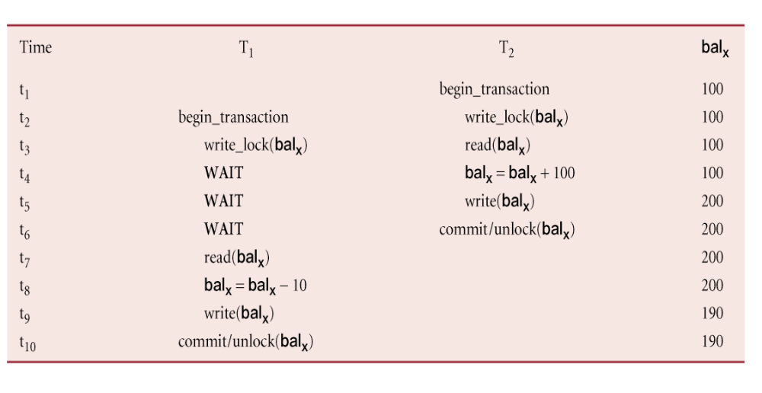
Preventing Lost Update Problem using 2PL

Slide 47
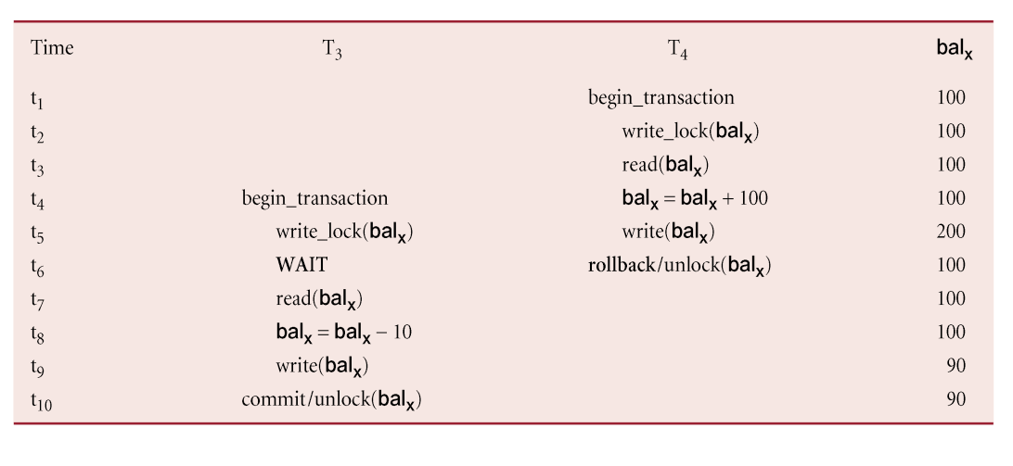
Preventing Uncommitted Dependency Problem using 2PL

Slide 48
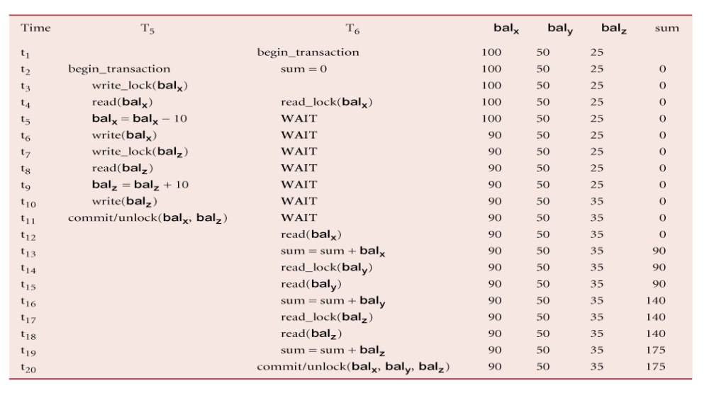
Preventing Inconsistent Analysis Problem using 2PL

Slide 49
Locking methods: problems
If every transaction in a schedule follows 2PL, schedule is serializable.
However, problems can occur with interpretation of when locks can be released.
Deadlock:
A bottleneck that may result when two (or more) transactions are each waiting for locks held by the other to be released.

Slide 50
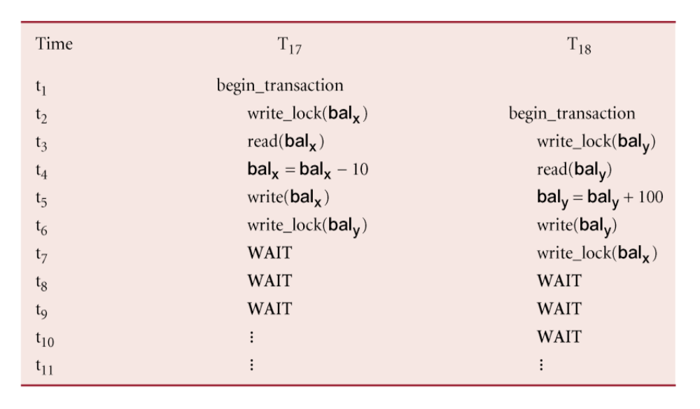
Deadlock - an example

Slide 51
Deadlock - possible solutions?
Only one way to break deadlock: abort one or more of the transactions.
Deadlock should be transparent to user, so DBMS should restart transaction (s).
Two general techniques for handling deadlock:
  Deadlock prevention.
  Deadlock detection and recovery.

Slide 52
Timeouts
Transaction that requests lock will only wait for a system-defined period of time.
If lock has not been granted within this period, lock request times out.
In this case, DBMS assumes transaction may be deadlocked, even though it may not be, and it aborts and automatically restarts the transaction.

Slide 53
Deadlock Prevention
DBMS looks ahead to see if transaction would cause deadlock and never allows deadlock to occur.
Could order transactions using transaction timestamps:
  Wait-Die - only an older transaction can wait for younger one, otherwise transaction is aborted (dies) and restarted with same timestamp.
  Wound-Wait - only a younger transaction can wait for an older one. If older transaction requests lock held by younger one, younger one is aborted (wounded).

Slide 54
Deadlock Detection and Recovery
DBMS allows deadlock to occur but recognizes it and breaks it.
Usually handled by construction of wait-for graph (WFG) showing transaction dependencies:
  Create a node for each transaction.
  Create edge Ti -> Tj, if Ti waiting to lock item locked by Tj.
Deadlock exists if and only if WFG contains cycle.
WFG is created at regular intervals.

Slide 55
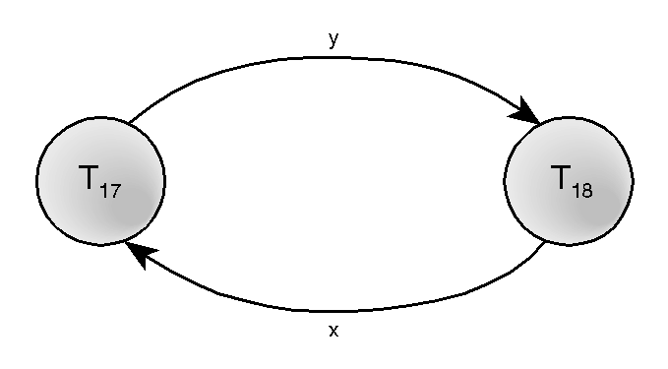
Example - Wait-For-Graph (WFG)

Slide 56
Recovery from Deadlock Detection
Several issues:
choice of deadlock victim;
how far to roll a transaction back;
avoiding starvation.

Slide 57
Timestamping
Transactions ordered globally so that older transactions, transactions with earlier timestamps, get priority in the event of conflict.
Conflict is resolved by rolling back and restarting transaction.
No locks so no deadlock.

Slide 58
Timestamping
Timestamp: a unique identifier created by DBMS that indicates relative starting time of a transaction.
Can be generated by:
• using system clock at time transaction started, or
• incrementing a logical counter every time a new transaction starts.

Slide 59
Timestamping - definition
Timestamping: a concurrency control protocol that orders transactions in such a way that older transactions get priority in the event of a conflict.
Read/write proceeds only if last update on that data item was carried out by an older transaction.
Otherwise, transaction requesting read/write is restarted and given a new timestamp.
Also timestamps for data items:
• read-timestamp: timestamp of last transaction to read item.
• write-timestamp: timestamp of last transaction to write item.

Slide 60
Timestamping: how does the protocol work?
A transaction T with timestamp ts(T) wants to read(x):
ts(T) < write_timestamp(x)
• x already updated by younger (later) transaction.
• Transaction T must be aborted and restarted with a new timestamp.
ts(T) ≥ write_timestamp(x)
• transaction can proceed
• read_timestamp = max(ts(T), read_timestamp(x))

Slide 61
Timestamping: how does the protocol work?
A transaction T with timestamp ts(T) wants to write(x):
ts(T) < read_timestamp (x)
• younger transaction has read the value x
• rollback transaction T and restart using a later timestamp
ts(T) < write_timestamp(x)
• x already written by younger transaction.
• Write can safely be ignored - ignore obsolete write rule.
all other cases: operation accepted and executed.

Slide 62
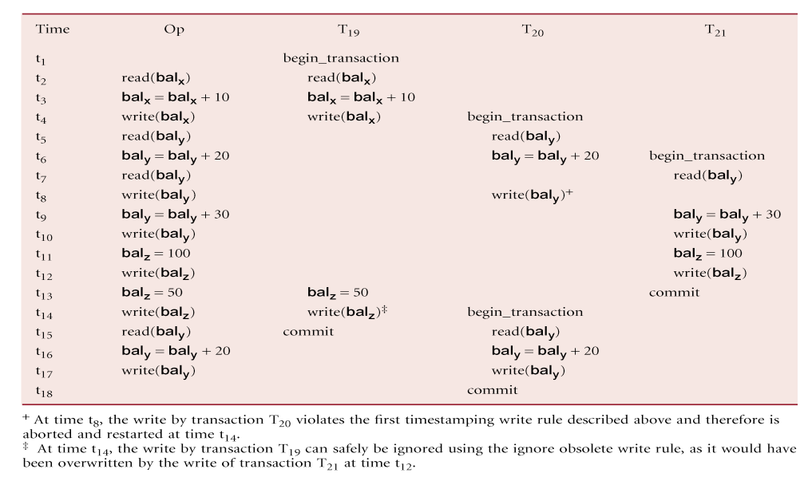
Example

Slide 63
Rare Conflicts
In some systems we can safely assume that conflicts are rare.
Do we really need locking or timestamping protocols?
No. More efficient techniques can be used to let transactions proceed without delays to ensure serializability.

Slide 64
Optimistic Techniques
At commit, check is made to determine whether conflict has occurred.
If there is a conflict, transaction must be rolled back and restarted.
Potentially allows greater concurrency than traditional protocols.
Three phases:
• Read
• Validation
• Write.

Slide 65
Optimistic Techniques - Read Phase
Extends from start until immediately before commit.
Transaction reads values from database and stores them in local variables. Updates are applied to a local copy of the data.

Slide 66
Optimistic Techniques - Validation Phase
Follows the read phase.
For read-only transaction, checks that data read are still current values. If no interference, transaction is committed, else aborted and restarted.
For update transaction, checks transaction leaves database in a consistent state, with serializability maintained.

Slide 67
Optimistic Techniques - Write Phase
Follows successful validation phase for update transactions.
Updates made to local copy are applied to the database.

Slide 68
Failure Classification
Transaction failure :
  Logical errors: transaction cannot complete due to some internal error condition
  System errors: the database system must terminate an active transaction due to an error condition (e.g., deadlock)
System crash: a power failure or other hardware or software failure causes the system to crash.
Disk failure: a head crash or similar disk failure destroys all or part of disk storage

Slide 69
Recovery Algorithms
Recovery algorithms are techniques to ensure database consistency and transaction atomicity and durability despite failures
Recovery algorithms have two parts
  Actions taken during normal transaction processing to ensure enough information exists to recover from failures
  Actions taken after a failure to recover the database contents to a state that ensures atomicity, consistency and durability

Slide 70
Different Crash Recovery methods
To ensure atomicity despite failures, we first output information describing the modifications to stable storage without modifying the database itself.
We study two approaches:
  log-based recovery, and
  shadow-paging
We assume (initially) that transactions run serially, that is, one after the other.

Slide 71
Shadow-Paging
This scheme is useful if transactions execute serially
Idea: maintain two page tables during the lifetime of a transaction –the current page table, and the shadow page table
Store the shadow page table in nonvolatile storage, such that state of the database prior to transaction execution may be recovered.
  Shadow page table is never modified during execution

Slide 72
Shadow-Paging
To start with, both the page tables are identical. Only current page table is used for data item accesses during execution of the transaction.
Whenever any page is about to be written for the first time
  A copy of this page is made onto an unused page.
  The current page table is then made to point to the copy
  The update is performed on the copy

Slide 73
Shadow Paging
Advantages of shadow-paging over log-based schemes
  no overhead of writing log records
  recovery is trivial

Slide 74
Shadow Paging
Disadvantages :
  Copying the entire page table is very expensive
    Can be reduced by using a page table structured like a B⁺-tree
  Commit overhead is high even with above extension
    Need to flush every updated page, and page table
  Data gets fragmented (related pages get separated on disk)
  After every transaction completion, the database pages containing old versions of modified data need to be garbage collected
  Hard to extend algorithm to allow transactions to run concurrently
    Easier to extend log based schemes

Slide 75
Log-Based Recovery
A log is kept on stable storage.
  The log is a sequence of log records, and maintains a record of update activities on the database.
Two approaches using logs:
  Deferred database modification
  Immediate database modification

Slide 76
Deferred Database Modification
The deferred database modification scheme records all modifications to the log, but defers all the writes to after partial commit. (final action of the tx. Is executed)
Crashes can occur while
  the transaction is executing the original updates, or
  while recovery action is being taken

Slide 77
Immediate Database Modification
The immediate database modification scheme allows database updates of an uncommitted transaction to be made as the writes are issued
  since undoing may be needed, update logs must have both old value and new value
Update log record must be written before database item is written
  We assume that the log record is output directly to stable storage
  Can be extended to postpone log record output, so long as prior to execution of an output(B) operation for a data block B, all log records corresponding to items B must be flushed to stable storage

Slide 78
Immediate Database Modification
Output of updated blocks can take place at any time before or after transaction commit
Order in which blocks are output can be different from the order in which they are written.

Slide 79
Checkpoints
Problems in recovery procedure as discussed earlier :
  searching the entire log is time-consuming
  we might unnecessarily redo transactions which have already
  output their updates to the database.
Streamline recovery procedure by periodically performing checkpointing
  Output all log records currently residing in main memory onto stable storage.
  Output all modified buffer blocks to the disk.
  Write a log record < checkpoint> onto stable storage.

Slide 80
Checkpoints
During recovery we need to consider only the most recent transaction T_{i} that started before the checkpoint, and transactions that started after T_{i}.
  Scan backwards from end of log to find the most recent <checkpoint> record
  Continue scanning backwards till a record <T_{i} start> is found.
  Need only consider the part of log following above start record. Earlier part of log can be ignored during recovery, and can be erased whenever desired.
  For all transactions (starting from T_{i} or later) with no <T_{i} commit>, execute undo(T_{i}). (Done only in case of immediate modification.)
  Scanning forward in the log, for all transactions starting from T_{i} or later with a <T_{i} commit>, execute redo(T_{i}).

Slide 81
Example of Checkpoints
T₁ can be ignored (updates already output to disk due to checkpoint)
T₂ and T₃ redone.
T₄ undone
T_{c}
T_{f}
T₁
T₂
T₃
T₄
checkpoint
system failure

